Slide 1
Chongqing University of Technology
ATAI
Advanced Technique of Artificial Intelligence
Chongqing University of Technology
Abstractive Multi-Document Summarization via Joint Learning with
Single-Document Summarization
Hanqi Jin, Xiaojun Wan
Center for Data Science, Peking University
Wangxuan Institute of Computer Technology, Peking University
The MOE Key Laboratory of Computational Linguistics, Peking University
——EMNLP 2020
2021.02.02 • ChongQing
Reported by Jia Wang

Slide 2
Chongqing University of Technology
ATAI
Advanced Technique of Artificial Intelligence
Chongqing University of Technology
1.Introduction
2.Method
3.Experiments
4.Conclusion

Slide 3
Introduction
In this work, we propose a joint learn_x0002_ing approach to improve neural abstractive multi-document summarization by using single_x0002_document summarization corpus to address these issues. Our approach first uses a shared document encoder to encode each document in the document set, then uses a shared decoder to predict the word probabilities for each document, and finally applies a decoding controller to aggregate all output prob_x0002_abilities from the summary decoder to make the final prediction at each decoding step. The shared encoder and decoder are jointly trained on the single document summarization data.
In this way,we can unify single-document and multi-document summarizations into one architecture simultane_x0002_ously, and make better use of single-document and multi-document corpora, so that both tasks can benefit from joint learning, especially for the multi_x0002_document summarization task.

Slide 4
Introduction
To the best of our knowledge, we are the first to explore joint learning for neural abstractive single-document and multi-document summarizations.
We propose a unified model by fully sharing encoder and decoder and utilizing a decoding controller to aggregate the decoder’s outputs for multiple input documents.
Experimental results show that our approach substantially outperforms several strong base_x0002_lines, and single document summarization is verified to be very helpful to neural abstractive multi-document summarization.
Notes:
Aspect：picture quality
Polarity：positive
Aspect：battery life
Polarity：negative

Slide 5
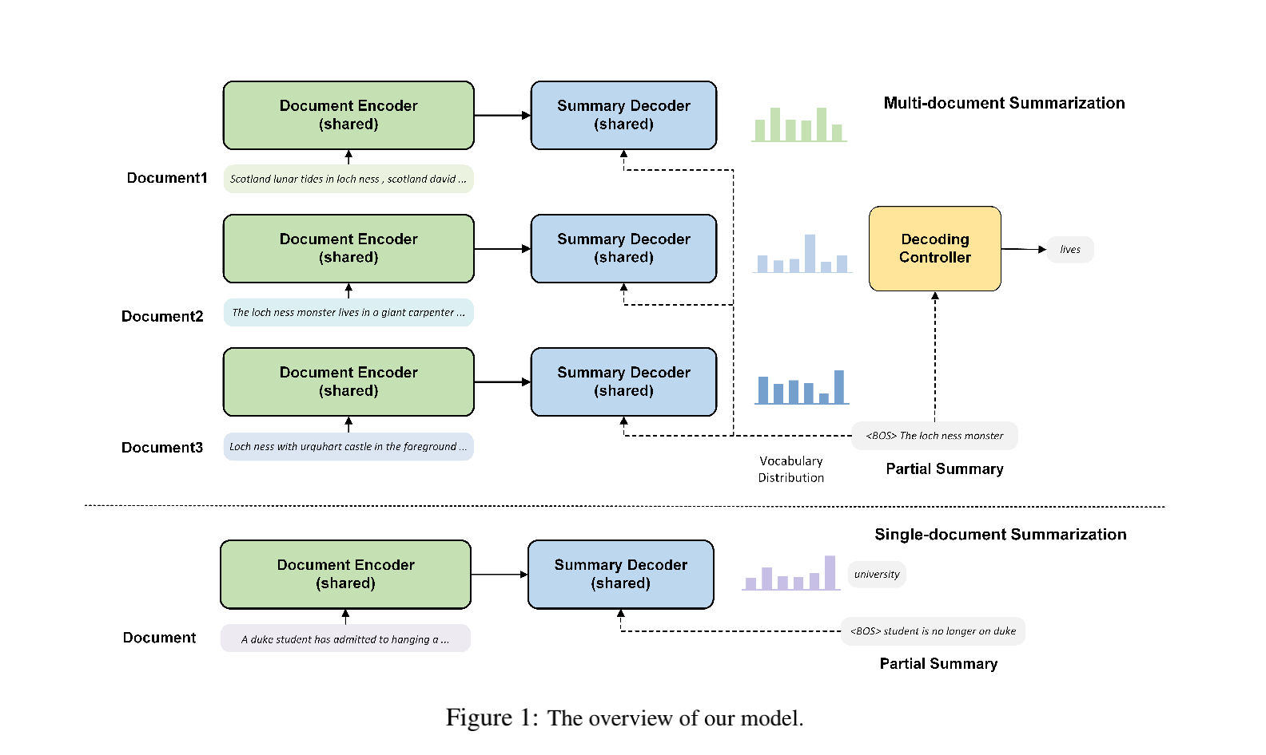
Method
Note that for multi-document summarization, the same sequence of previous words (i.e.partial summary) is used for decoding for every document of the multiple inputs.
Here is the importance weight for each of the multiple vocabulary distributions in the t-th step.

Slide 6
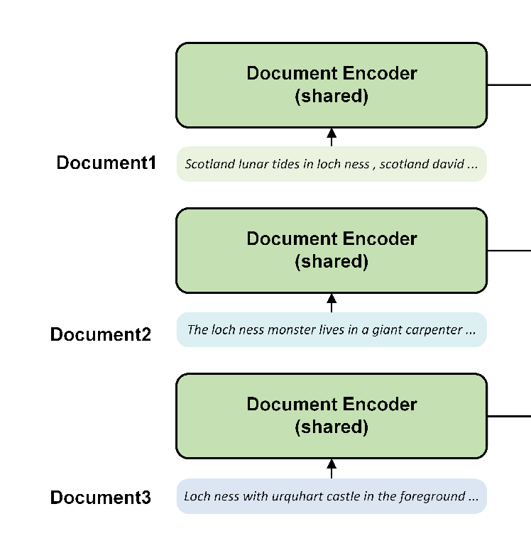
Method
Each layer has two sub-layers, where the first sub-layer is a multi-head self-attention mechanism, and the second sub-layer is a position-wise fully connected feed-forward network.
We take
as the input to the document encoder.
For convenience,we denote the output for the document as

Slide 7
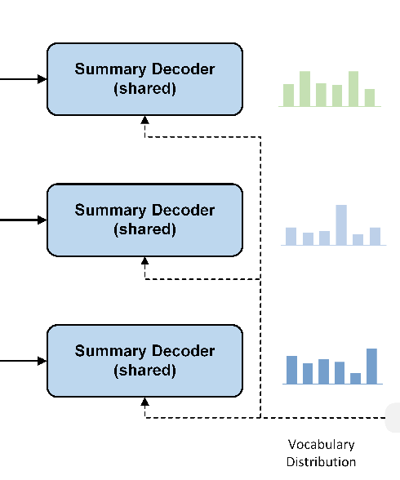
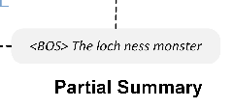
Method
The layer consists of three sub-layers: masked multi-head self-attention mechanism, multi-head cross-attention mechanism over the output of the encoder stack, and position-wise feed-forward network.

Slide 8
Method

Slide 9
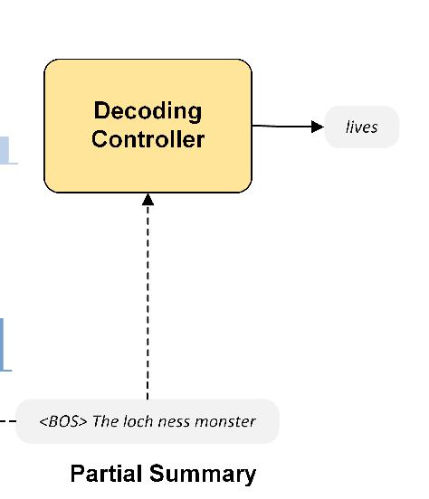
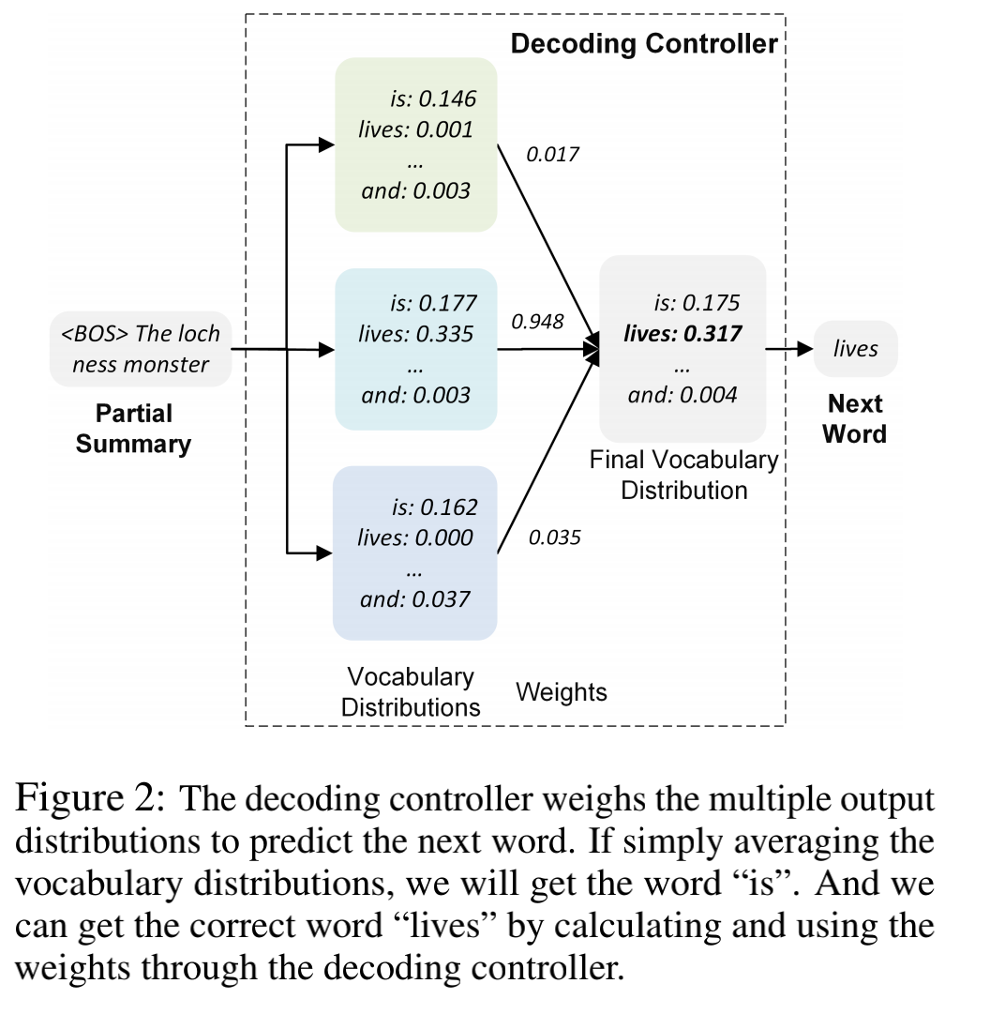
Method
尼斯湖水怪
We first use an attention pooling over the document encoder outputs to obtain corresponding document representation, and adopt a bidirectional LSTM to encode multiple document representations in the document cluster. Then,we take the output of the bidirectional LSTM as the initial state of another unidirectional LSTM, which will be used to calculate the weights that the next word comes from each document.

Slide 10
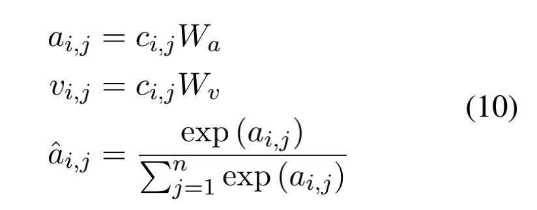
Method
We first use an attention pooling over the document encoder outputs to obtain corresponding document representation, and adopt a bidirectional LSTM to encode multiple document representations in the document cluster. Then,we take the output of the bidirectional LSTM as the initial state of another unidirectional LSTM, which will be used to calculate the weights that the next word comes from each document.

Slide 11
Method
We first use an attention pooling over the document encoder outputs to obtain corresponding document representation, and adopt a bidirectional LSTM to encode multiple document representations in the document cluster. Then,we take the output of the bidirectional LSTM as the initial state of another unidirectional LSTM, which will be used to calculate the weights that the next word comes from each document.

Slide 12
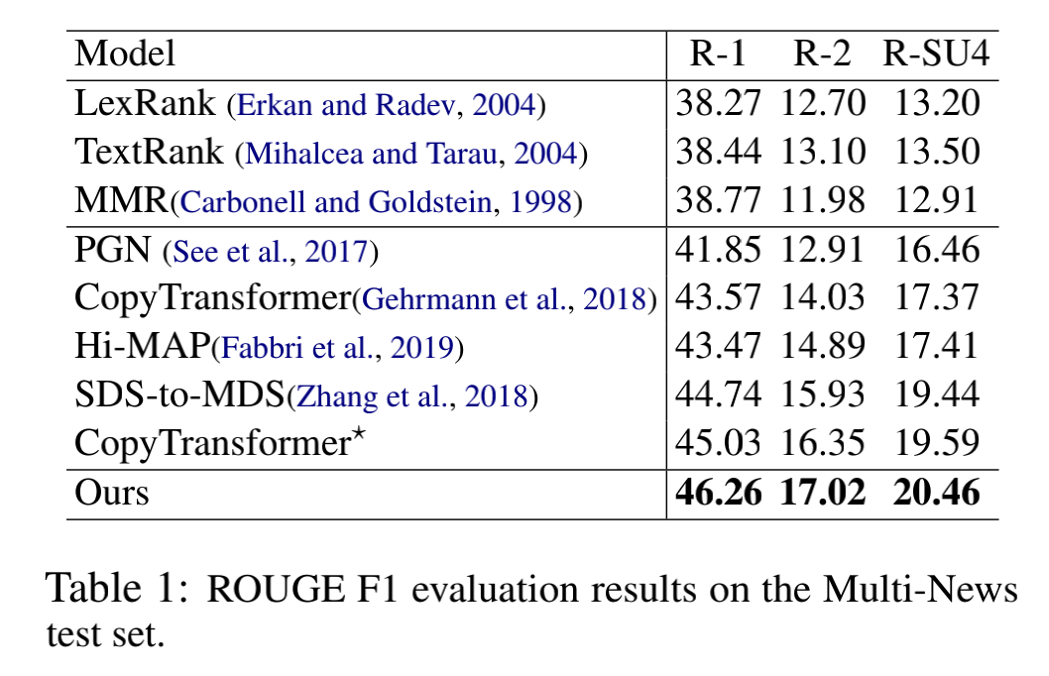
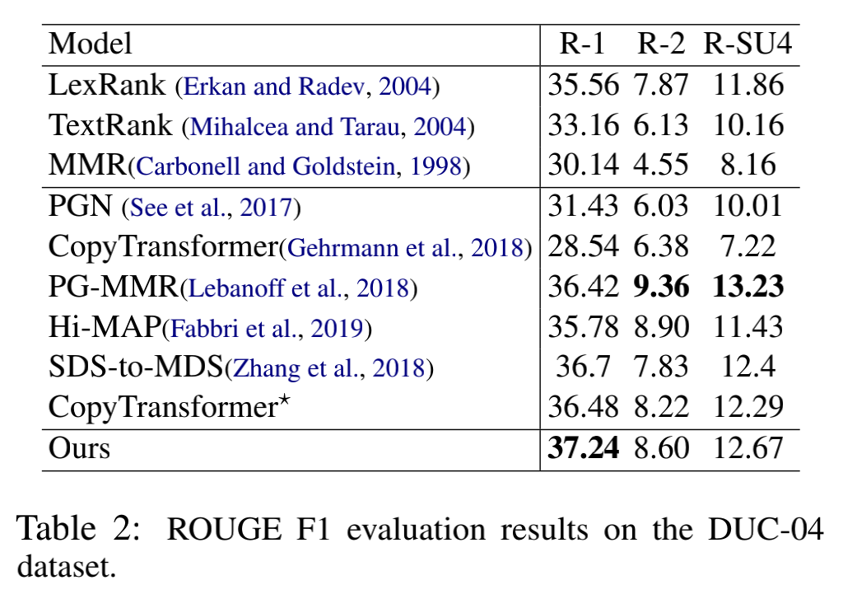
Experiments

Slide 13
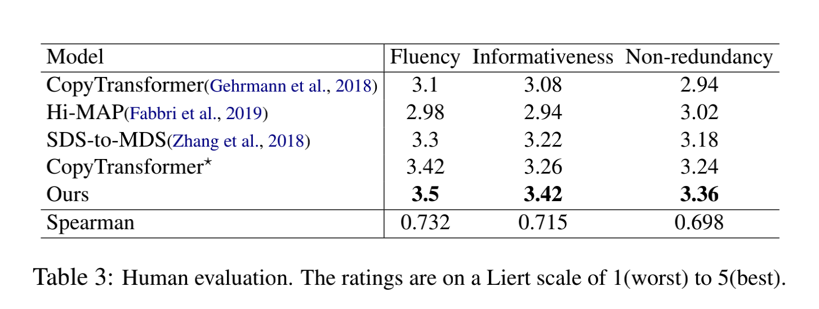
Experiments

Slide 14
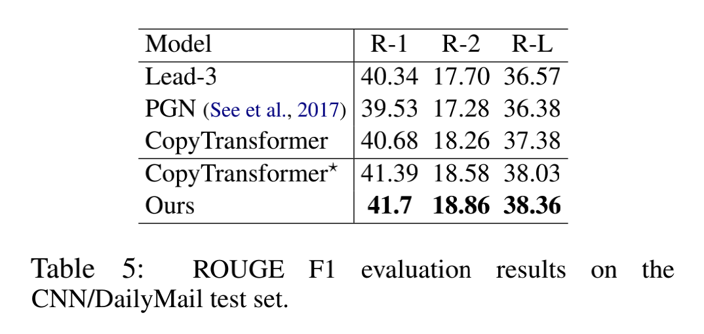
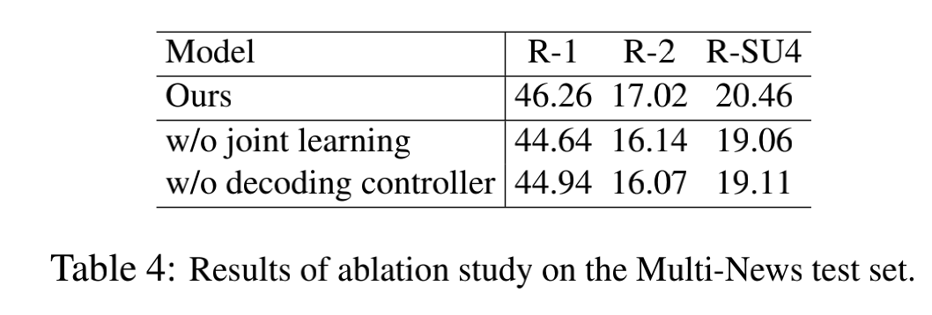
Experiments

Slide 15
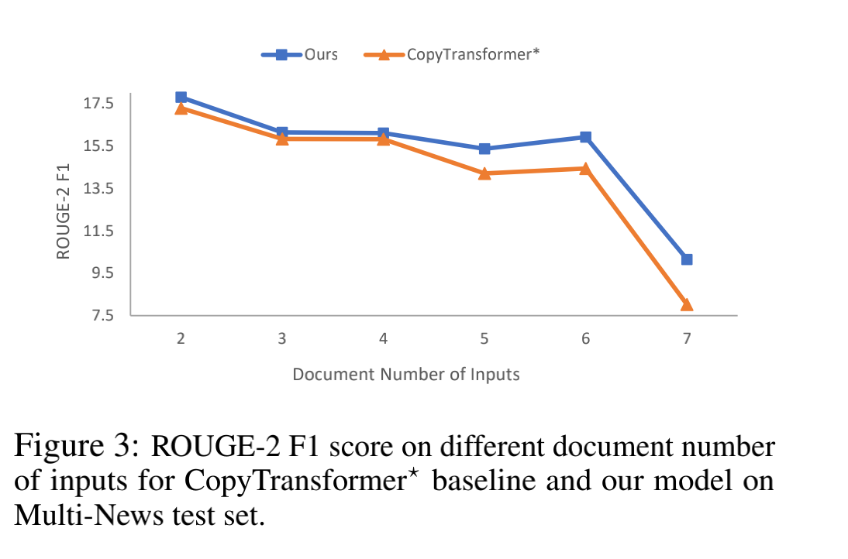
Experiments

Slide 16
Conclusion
In this paper, we propose a joint learning approach to improve neural abstractive multi-document sum_x0002_marization by using single-document summarization dataset. Specifically, we use the shared doc_x0002_ument encoder and summary decoder to process each document in the document set, and apply a de_x0002_coding controller to aggregates all output probabili_x0002_ties from the summary decoder for multi-document summarization. The shared encoder and decoder are jointly trained on the single document sum- marization dataset. Experimental results show that our approach substantially outperforms sev_x0002_eral strong multi-document summarization base_x0002_lines and achieves state-of-the-art or very compet_x0002_itive performances on Multi-News and DUC-04 datasets.

Slide 17
Thank you!

